Slide 1
SW Programming Project
#4. (Final)

Slide 2
Criteria
To search the most appropriate file relevant to ‘keyword’, I think the ‘level of relevance’ is determined by how useful the files are.
And I design 4 criteria to generalize which file is most useful.
1. Is ‘file name’ include the keyword?
2. How many times the keyword appear in files.
3. Is the keyword distributed regularly in file?
4. How early the keyword appear. << necessary again.
5.) How many words are meaningful.

Slide 3
+) Details
User can search the file by using keywords, regardless of upper or lower case. (Same as contents of file)
computer = CoMpuTEr
User can search the file by using ‘multiple keywords’ which contains white space, like “Personal communications” or “computer software”.
Program can separates the ‘meaningful word’.

Slide 4
+) Details
Meaningful Word.
=don’t place between exceptional character.
ex) keyword [me] in A[me]rica is meaningless.
( )[keyword]( ) - Highest weight.
( )[keyword](w) - 2nd …..
(w)[keyword]( ) - 3rd.....
(w)[keyword](w) - meaningless

Slide 5
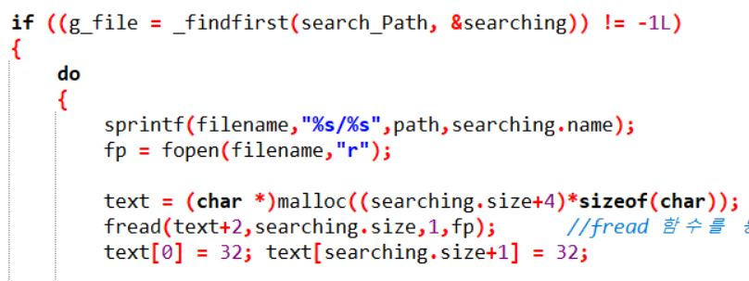
Coding

Slide 6
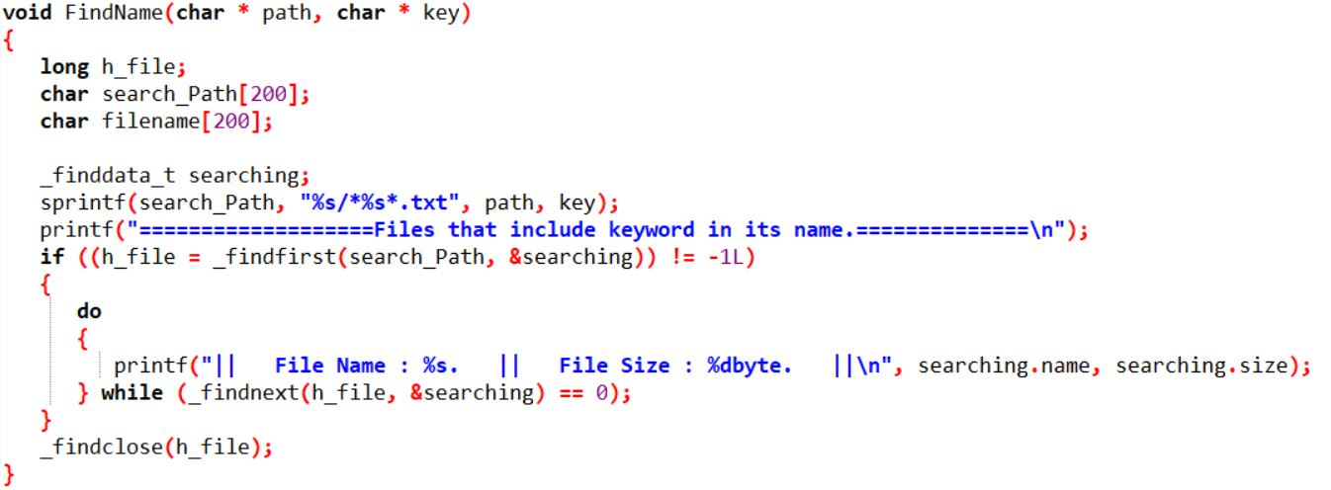
Coding

Slide 7
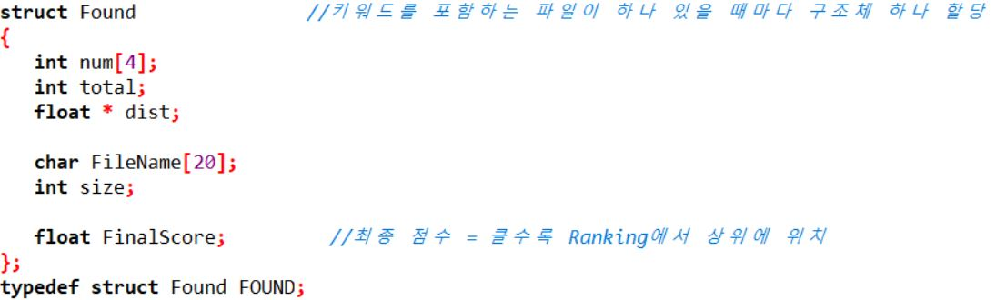
Coding

Slide 8
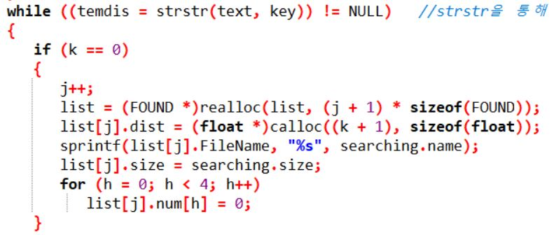
Coding

Slide 9
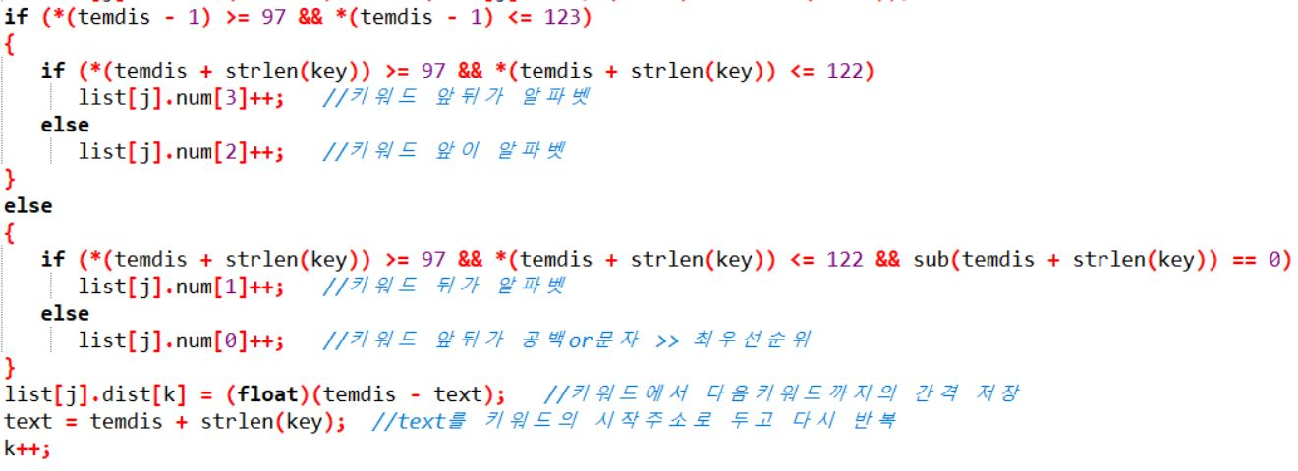
Coding

Slide 10
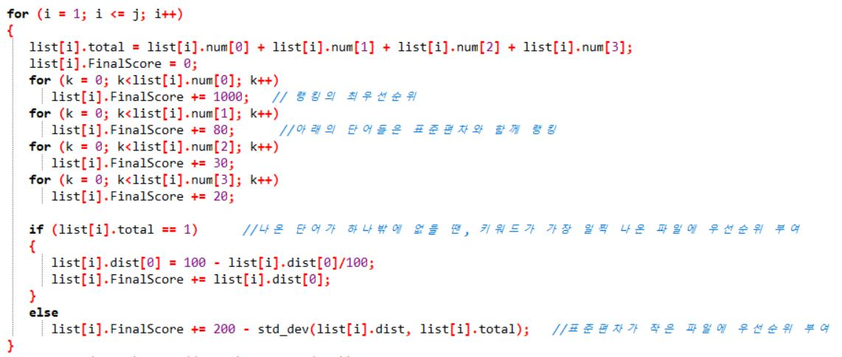
Coding

Slide 11
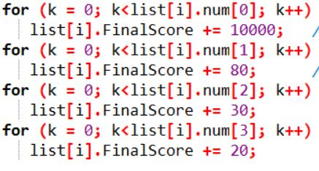
Ranking
Weight
( )[keyword]( ) - 10
( )[keyword](w) - 0.8
(w)[keyword]( ) - 0.4
(w)[keyword](w) - 0.2
Ex) The file have 6,1,3,2 number of words in a file,
6*10 + 1*0.8 + 3*0.4 + 2*0.2 = 8.6

Slide 12
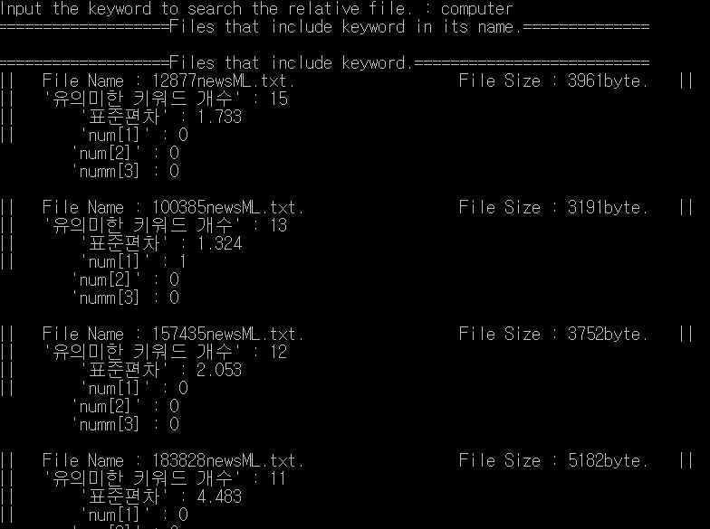
Implement

Slide 13
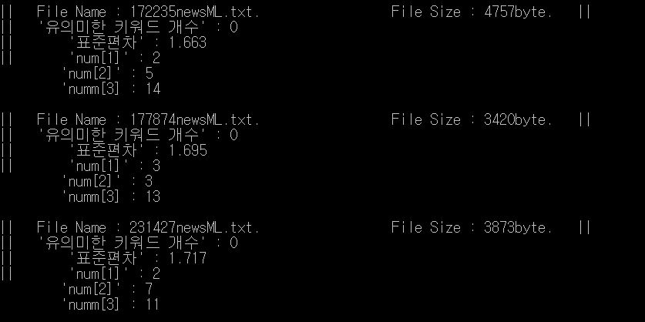
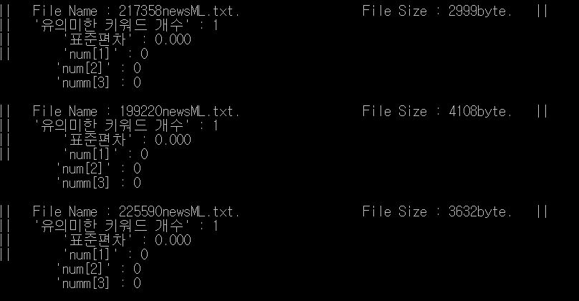
Implement

Slide 14
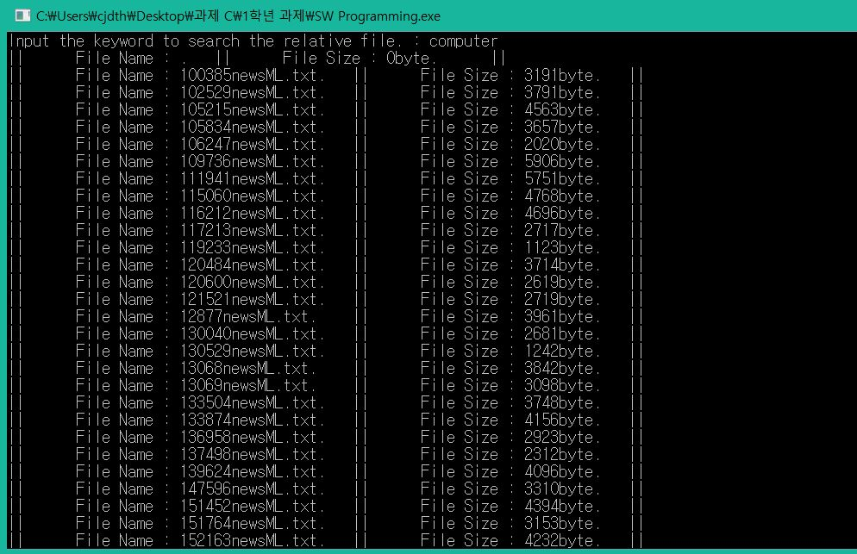
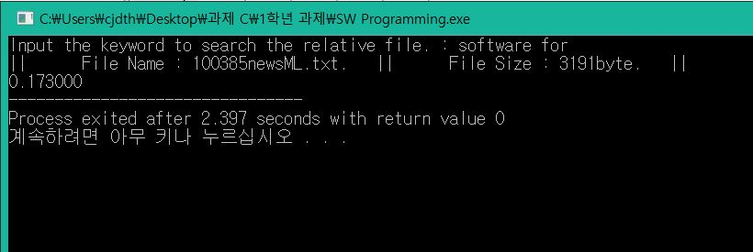
Implementation
This example doen’t include ranking algorithm because I reapairing it because of standard deviation
User can search multiple words.

